Slide 1


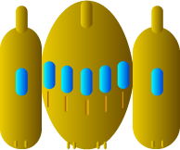
Moving our spaceship
0
width = 900 px
X
Y
X = play.width / 2 = 900 / 2 = 450
Y
>
this.spaceshipSpeed = 200
this.upSec = 0,01666667
200 * 0,01666667 = 3,34
X
X = 450 + 3,34 = 453,34

